Slide 1
Science of Living System
BS20001
Ritobrata Goswami
School of Bioscience
Email: ritobrata.goswami@iitkgp.ac.in
Tel: 03222-260518

Slide 2
Why study Living System?

Slide 3
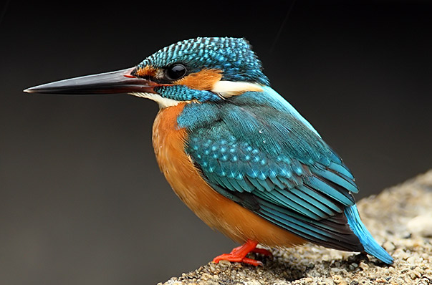
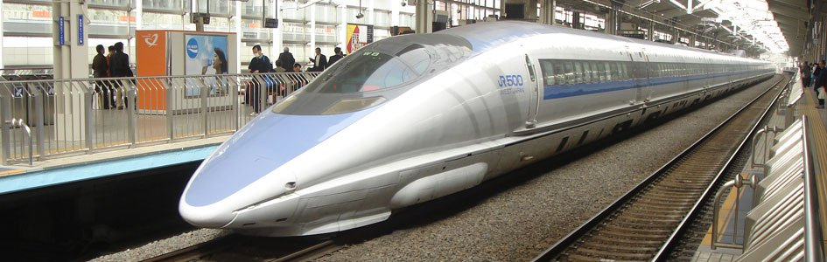
Shinkansen Bullet Train in Japan: inspired by shape of Kingfisher head
Eiji Nakatsu
Notes:
Shinkansen Bullet Train
High-speed trains can literally cause headaches. That's why Japan limits their acceptable noise-pollution level, which can be particularly high when the trains emerge from tunnels.
Eiji Nakatsu, a bird-watching engineer at the Japanese rail company JR-West, in the 1990s took inspiration from the kingfisher, a fish-eating fowl that creates barely a ripple when it darts into water in search of a meal. He was fascinated by the silent, smooth, and high-speed swoops of birds such as kingfishers and owls. The kingfisher’s beak was noticed for its efficiency to slice through water to catch a fish. Based on those aspects with a parallel to nature’s designs, the Shinkansen was re-designed with a pointed front similar to the beak of the kingfisher.
The redesigned train was not only acceptably quieter when it exited the tunnels in dense residential areas, it was also 10 per cent faster and 15 per cent more energy-efficient.
Photographers: Hiromi Okano/Corbis; West Japan Railway Co. Via Bloomberg

Slide 4
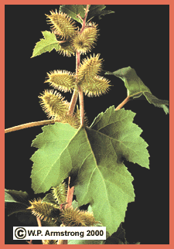
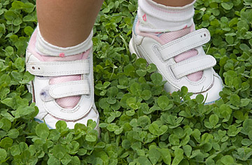
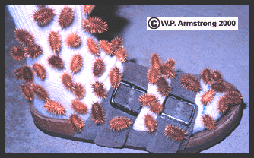
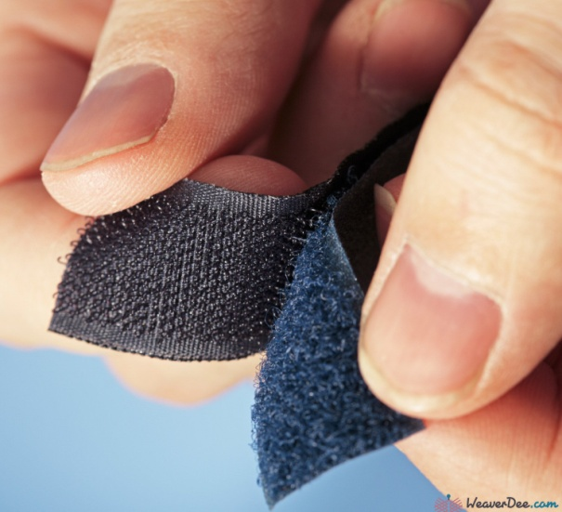
Invention of Velcro®: inspired by Cockleburs
Cockleburs
Georges de Mestral invented Velcro®: Unique, two-sided fastener, one side with stiff hooks like the burs and the other side with soft loops like the fabric. a combination of the words velour and crochet.
Notes:
One day in 1948, an amateur Swiss mountaineer and naturalist, George de Mestral, went on a nature walk with his dog through a field of hitchhiking bur plants. He and his dog returned home covered with burs. With an intense curiosity, Mestral went to his microscope and inspected one of the many burs stuck to his pants. He saw numerous small hooks that enabled the seed-bearing bur to cling so tenaciously to the tiny loops in the fabric of his pants. George de Mestral raised his head from the microscope and smiled thinking, "I will design a unique, two-sided fastener, one side with stiff hooks like the burs and the other side with soft loops like the fabric of my pants. I will call my invention Velcro® a combination of the words velour and crochet. It will rival the zipper in it's ability to fasten."

Slide 5
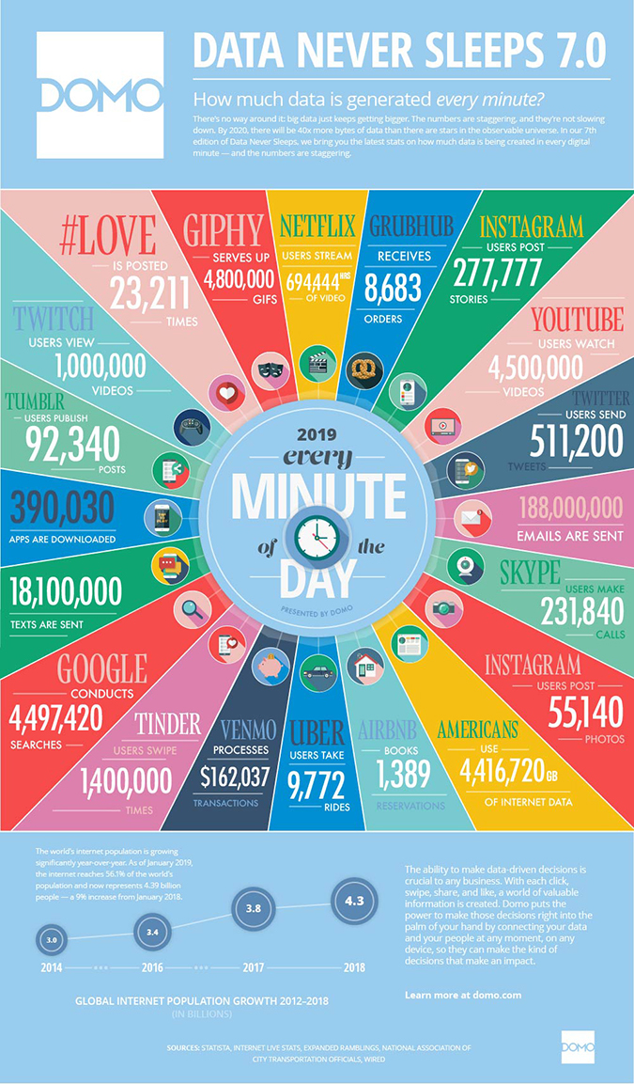
Data usage: a big deal
Notes:
India has the highest average data usage per smartphone, reaching 9.8 GB per month at the end of 2018, according to a new study by Ericsson. To reach 18 GB per month per smartphone by 2024.
In 2018, mobile data traffic per smartphone per month stood at
7 GB for North America
3.1 GB for Latin America
6.7 GB for Western Europe
4.5 GB for Central and Eastern Europe
7.1 GB for northeast Asia
3.6 GB for southeast Asia and Oceania region
"Today, more than 5 billion consumers interact with data every day — by 2025, that number will be 6 billion, or 75% of the world's population. In 2025, each connected person will have at least one data interaction every 18 seconds. Many of these interactions are because of the billions of IoT devices connected across the globe, which are expected to create over 90 ZB of data in 2025."

Slide 6
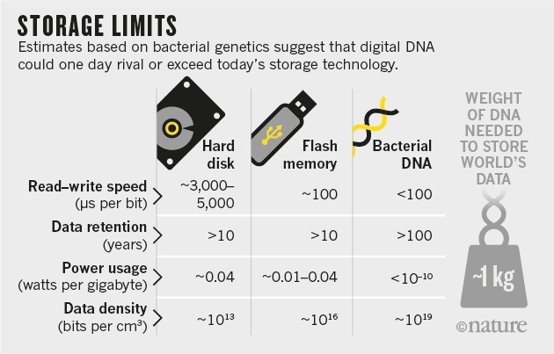
Why study Living System?
Notes:
Floppy disks had their storage limits, and data storage moved on to CDs, then DVDs, then Zip drives, and then SD cards. USB flash drives reigned. Companies like Amazon, Google, and Dropbox unveiled cloud storage to the masses in 2011.
Cloud storage may soon run out. Data stored on the cloud are not actually on a “cloud”, they are stored in data centers mostly in Europe, the U.S., and the Asia-Pacific, often in places where electricity is cheap.
So what’s the solution?
DNA-based data storage. DNA—consists of long chains of the nucleotides A, T, C and G —is life’s information-storage material. Data can be stored in the sequence of these letters, turning DNA into a new form of information technology. It is routinely sequenced, synthesized and accurately copied with ease. DNA is also very stable. Storing does not require much energy.

Slide 7
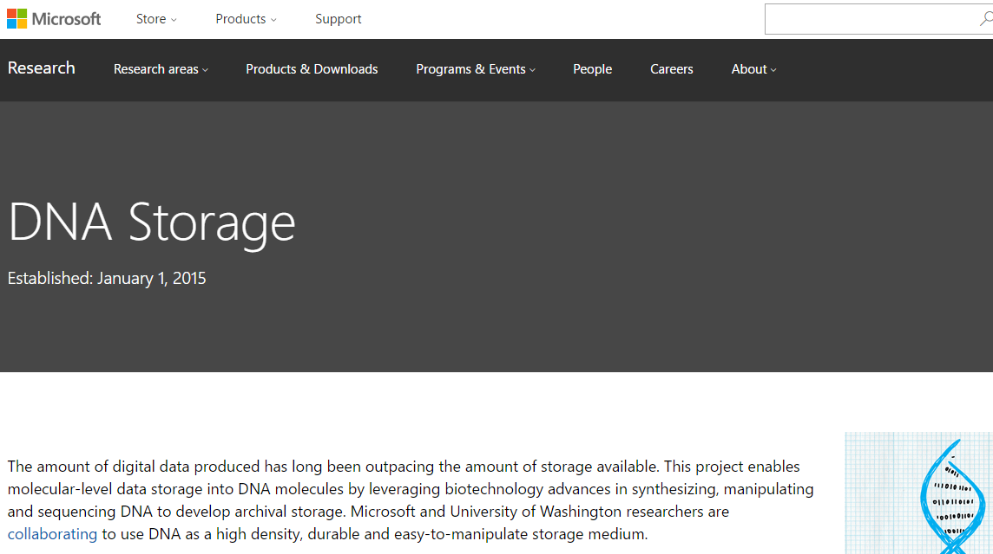
Microsoft Corporation – DNA Storage Research
A DNA-Based Archival Storage System Bornholt J, et. al. ASPLOS 2016 (International Conference on Architectural Support for Programming Languages and Operating Systems)
https://youtu.be/60Gi5lqL-dA
Notes:
It is the storage capacity that shines. DNA can accurately stow massive amounts of data at a density far exceeding that of electronic devices. The simple bacterium Escherichia coli, for instance, has a storage density of about 10¹⁹ bits per cubic centimeter, according to calculations published in 2016 in Nature Materials by George Church of Harvard University and his colleagues. At that density, the world’s current storage needs for a year could be met by a cube of DNA measuring about one meter on a side.

Slide 8
What are the characteristics of a Living System?
High degree of complexity
Mechanisms for sensing and responding to alterations in surroundings
Systems for extracting, transforming and using energy from the environment
Ability to adapt and evolve
Ability to develop and grow
Capacity for precise self-replication and self-assembly, known as reproduction

Slide 9
Components of Living Systems C-H-O-N-S-P
All life forms on Earth are composed of building blocks that are made of combinations of Carbon and other elements:
Hydrogen
Oxygen
Nitrogen
Sulphur
Phosphorus

Slide 10
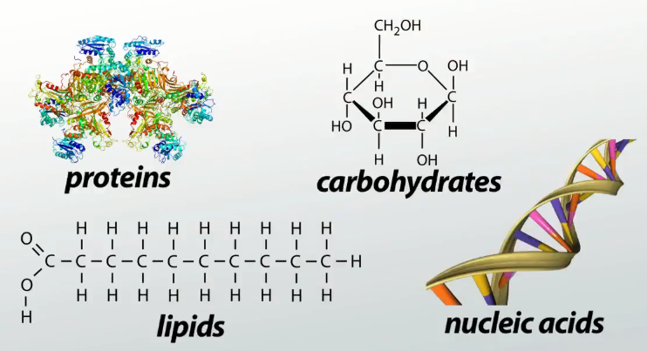
Molecules of Living Systems: Biological Macromolecules
Notes:
Many critical nutrients are biological macromolecules. The term “macromolecule” was first coined in the 1920s. Many large biological molecules are built by covalently linking smaller biological molecules together.
Biological macromolecules play a critical role in cell structure and function. Most (but not all) biological macromolecules are polymers, which are any molecules constructed by linking together many smaller molecules, called monomers. Examples of these monomers and polymers can be found in the sugar you might put in your coffee or tea. Regular table sugar is the disaccharide sucrose (a polymer), which is composed of the monosaccharides fructose and glucose (which are monomers).
Biological macromolecules all contain carbon in ring or chain form, which means they are classified as organic molecules. They usually also contain hydrogen and oxygen, as well as nitrogen and additional minor elements.
There are four major classes of biological macromolecules:
carbohydrates
lipids
proteins
nucleic acids
Each of these types of macromolecules performs a wide array of important functions within the cell; a cell cannot perform its role within the body without many different types of these crucial molecules. In combination, these biological macromolecules make up the majority of a cell’s dry mass. All the molecules both inside and outside of cells are situated in a water-based (i.e., aqueous) environment, and all the reactions of biological systems are occurring in that same environment.

Slide 11
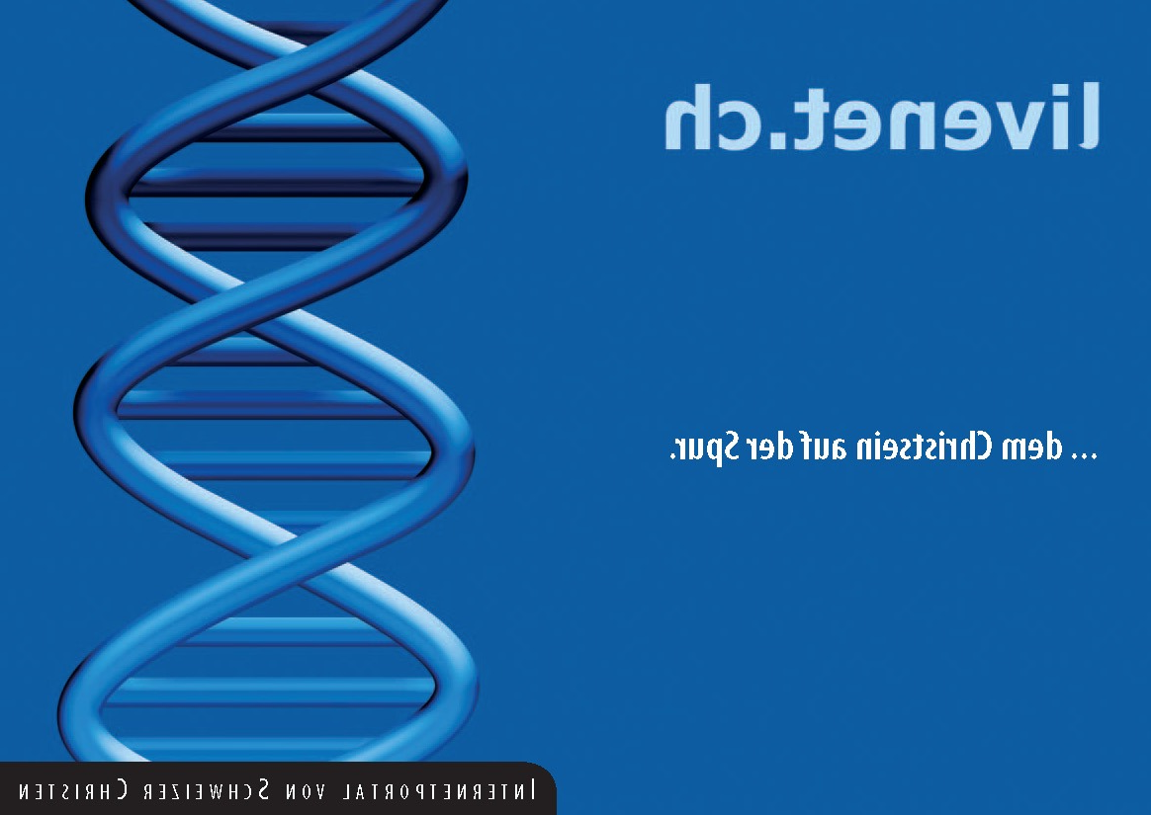
Date | Topic | Sec-(1+2) (RG+AD+DS)
13/01/2021 | Nucleic acids | RG
20/01/2021 | Nucleic acids | RG
27/01/2021 | Transcription | DS
03/02/2021 | Translation and Proteins | DS
10/02/2021 | Proteins | DS
17/02/2021 | Enzymes | RG
24/02/2021 | Microscope, cell structure & cytoskeleton | AD
10/03/2021 | Cell division and stem cells | AD
17/03/2021 | Neurobiology | AD
24/03/2021 | Virus and human diseases | AD
31/03/2021 | Immune system | RG
07/04/2021 | Genetic engineering | DS
14/04/2021 | Written Exam
03/03/21: Spring Break

Slide 12
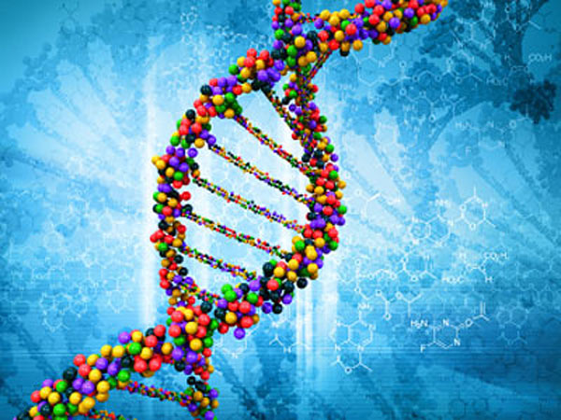
Nucleic Acid

Slide 13
Nucleic Acid
RNA: Ribonucleic Acid
DNA: Deoxyribonucleic Acid
Notes:
Nucleic acid is an important class of macromolecules found in all cells and viruses. The functions of nucleic acids have to do with the storage and expression of genetic information. Deoxyribonucleic acid (DNA) encodes the information the cell needs to make proteins. A related type of nucleic acid, called ribonucleic acid (RNA), comes in different molecular forms that participate in protein synthesis.

Slide 14
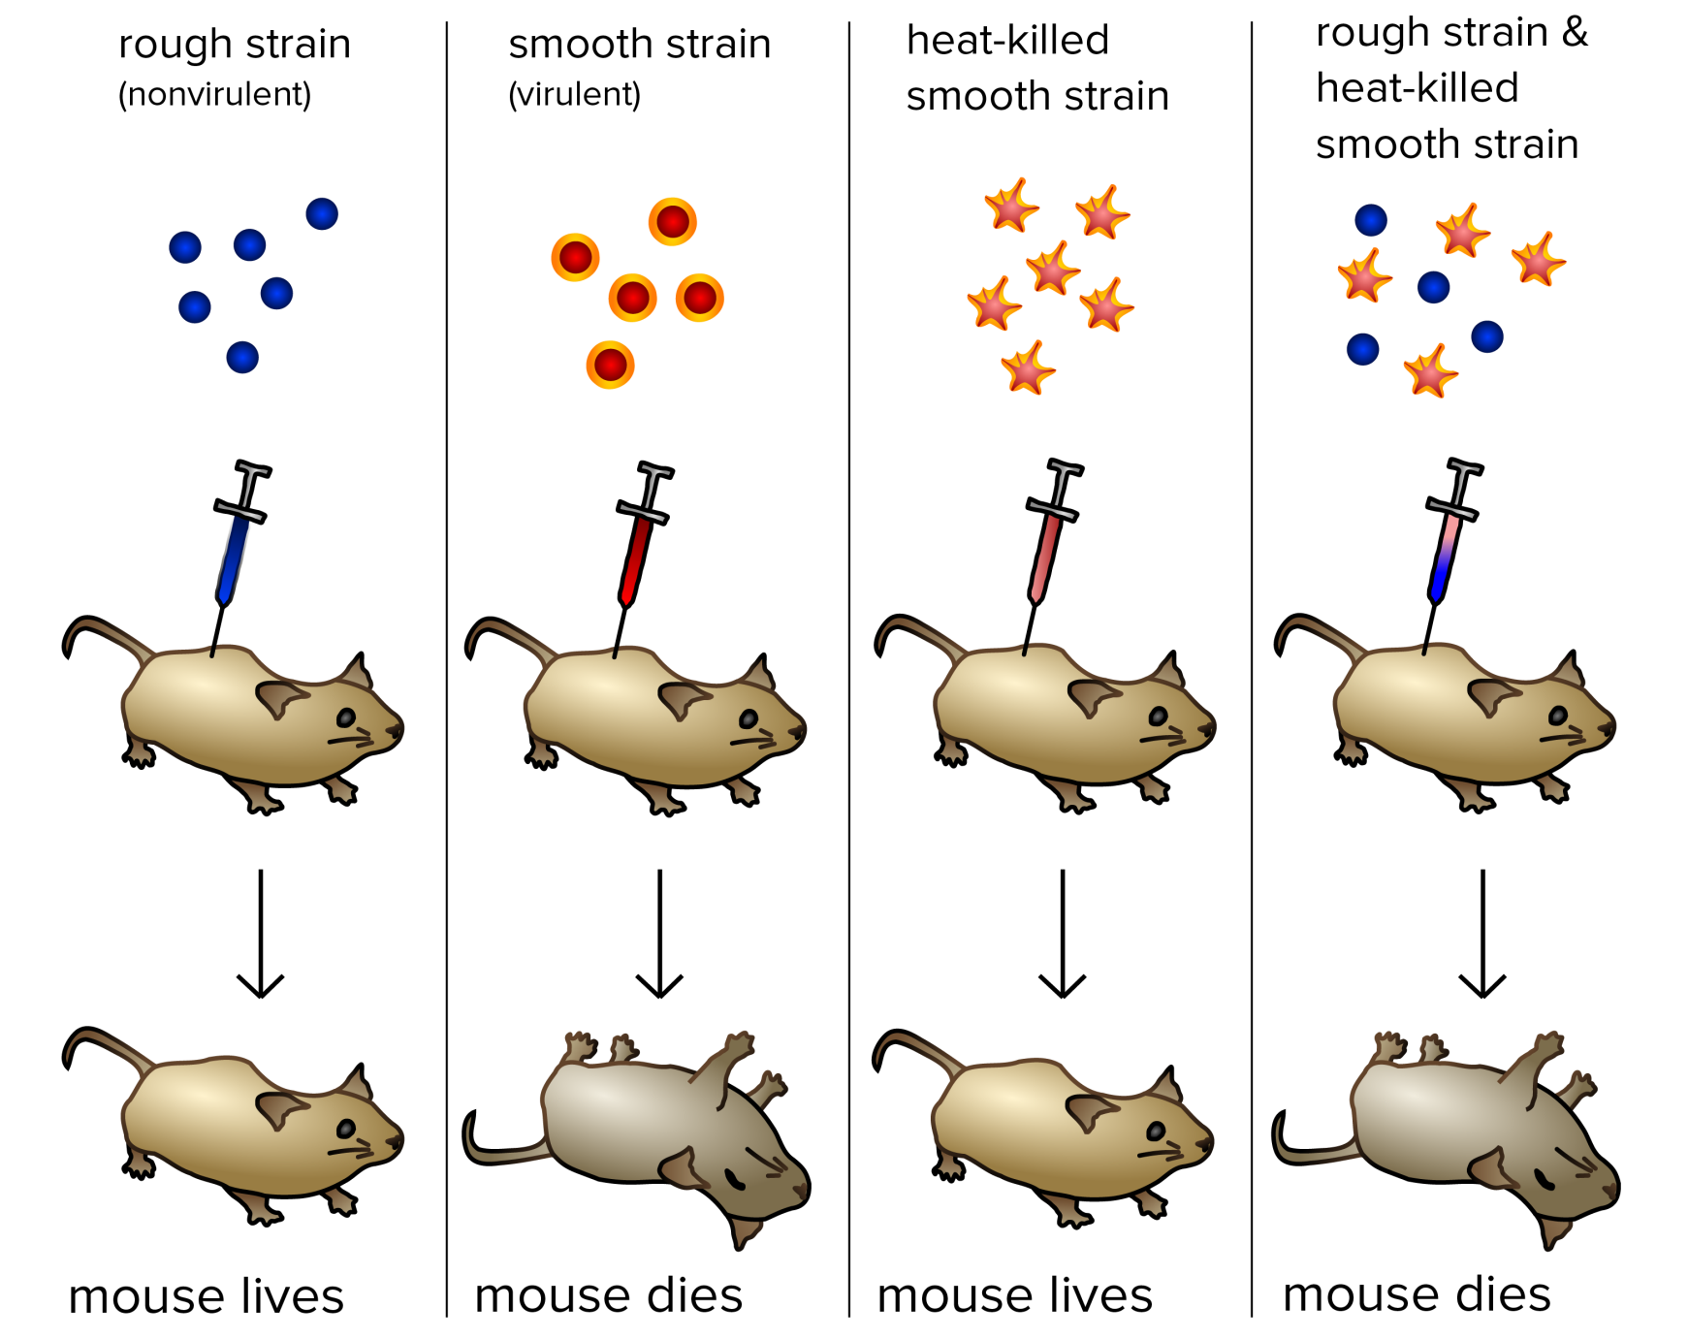
Experiment that Proves DNA is Our Genetic Material
Frederick Griffith’s experiment with bacteria (Streptococcus pneumoniae) (1928).
Notes:
Frederick Griffith was a British bacteriologist whose focus was the epidemiology and pathology of bacterial pneumonia. Pneumonia was a serious cause of death during post-WWI Spanish flu pandemic, and Griffith was studying the possibility of creating a vaccine. Griffith's findings were followed by research in the late 1930s and early 40s that isolated DNA as the material that communicated this genetic information.
Griffith used two strains of pneumococcus (Streptococcus pneumoniae) bacteria which infect mice – a type S (smooth) which was virulent, and a type -R (rough) strain which was nonvirulent. The S strain synthesized a polysaccharide capsule that protected itself from the host's immune system, resulting in the death of the host, while the R strain did not have that protective capsule and was defeated by the host's immune system.
For the first stage of the transforming principle experiment, Griffith showed that mice injected with S died but when injected with R lived and showed few symptoms. The next stage showed that if the mice were injected with type S that had been killed by heat, the mice all lived, indicating that the bacteria had been rendered ineffective.
The interesting results came with the third part of the experiment, where mice were injected with a mixture of heat killed S and live R. Interestingly enough, the mice all died, indicating that some sort on information had been passed from the dead type S to the live type R. Blood sampling showed that the blood of the dead mice contained both live type S and live type R bacteria.
Somehow the type S had been transformed into the type R strain, a process he called ‘the transforming principle’.
Today, we know that the "transforming principle" Griffith observed was the DNA of the S strain bacteria. While the bacteria had been killed, the DNA had survived the heating process and was taken up by the R strain bacteria. The S strain DNA contains the genes that form the smooth protective polysaccharide capsule. Equipped with this gene, the former R strain bacteria were now protected from the host's immune system and could kill the host.
This discovery was followed by the famous Avery, MacLeod and McCarty’s 1944 experiment to show that genetic material is DNA. They digested transforming extract with DNase to show loss of transforming ability. And when they just purified DNA from the extract, that successfully transformed non-virulent bacteria into virulent form.

Slide 15
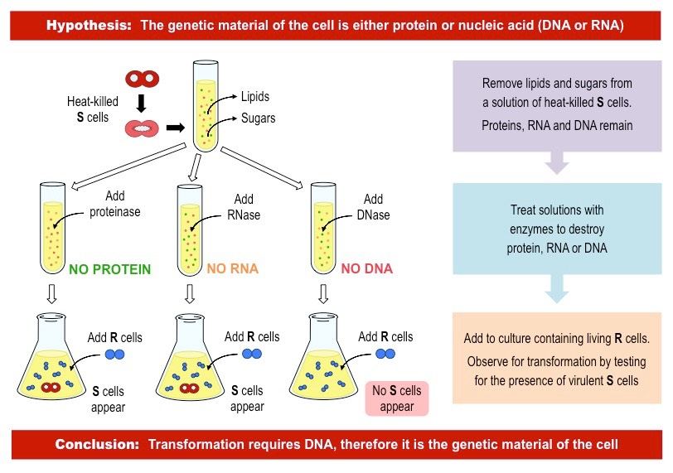
Experiment that Proves DNA is Our Genetic Material
Notes:
Bacteriologists suspected the transforming factor was some kind of protein. The transforming principle could be precipitated with alcohol, which showed that it was not a carbohydrate like the polysaccharide coat itself. But Avery and McCarty observed that proteases - enzymes that degrade proteins - did not destroy the transforming principle. Neither did lipases - enzymes that digest lipids. They found that the transforming substance was rich in nucleic acids, but ribonuclease, which digests RNA, did not inactivate the substance. They also found that the transforming principle had a high molecular weight. They had isolated DNA. This was the agent that could produce an enduring, heritable change in an organism.
Until then, biochemists had assumed that deoxyribonucleic acid was a relatively unimportant, structural chemical in chromosomes and that proteins, with their greater chemical complexity, transmitted genetic traits.

Slide 16
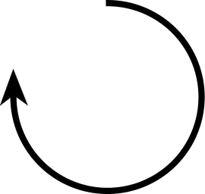
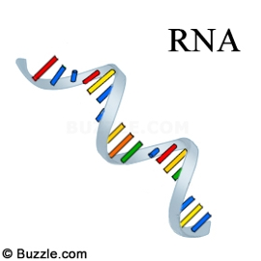
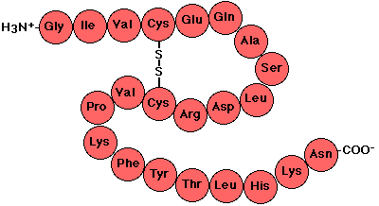
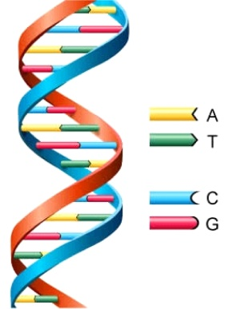
Flow of Genetic Information:
The Central Dogma of Molecular Biology
DNA Polymerase
RNA Polymerase
Ribosome
DNA
RNA
Protein
Transcription
Translation
Replication
DNA
RNA
Protein
Polymer of nucleotides
Polymer of nucleotides
Polymer of amino acids
Notes:
The central dogma of life was proposed by Francis Crick ca 1956. Here the arrows indicate the direction of transfer of genetic information. The circular arrow on DNA refers to the fact that DNA is the template for its self-replication. This is carried out by the enzyme DNA polymerase. DNA also serves as the template for RNA synthesis during transcription and this is catalyzed by the enzyme RNA polymerase. Finally, the information encoded on RNA (messenger RNA to be precise) is used to synthesize proteins by ribosomes. DNA, RNA and proteins are all polymers. The monomeric unit for DNA and RNA are called nucleotides whereas for proteins they are amino acids.

Slide 17
Nucleic Acid
Nucleic acids are polymers
Monomer---nucleotides
Nitrogenous bases
Purines
Pyrimidines
Sugar
Ribose
Deoxyribose
Phosphates
Nucleosides
Nucleotides
Notes:
Nucleic acids (DNA and RNA) are polymers. The monomeric units are called nucleotides, which have three components: nitrogenous bases, sugar and phosphate.

Slide 18
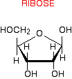
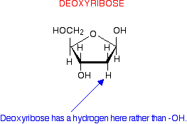
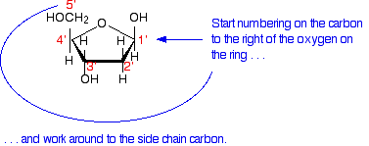
RNA vs DNA – Sugar

Slide 19
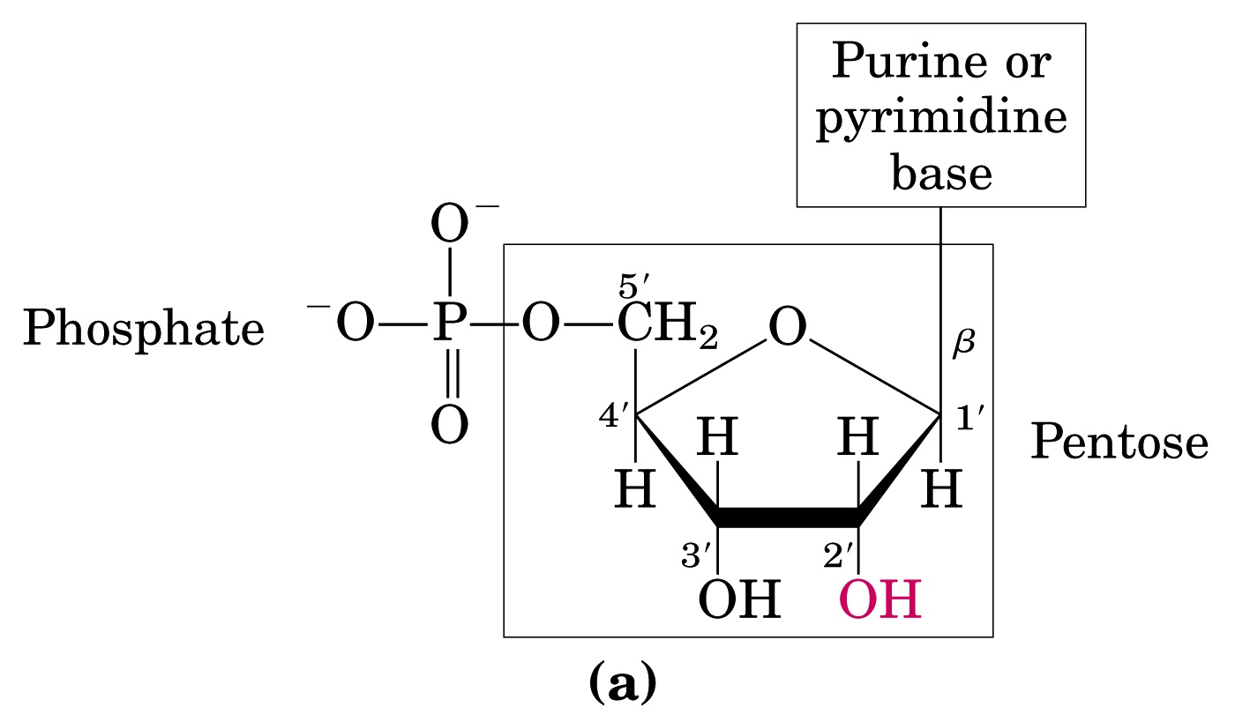
RNA vs DNA – Sugar
RNA - Ribonucleic Acid
DNA - Deoxyribonucleic Acid
(OH)
(H)
N-β-glycosyl bond
(Ribose)
Ester Bond
Notes:
The sugar has five carbons and has the common name Pentose. The numbering of the carbon atoms are shown (important!) and are followed by the symbol prime (‘) to distinguish them from the numbered atoms on the nitrogenous bases. Nucleic acids have two kinds of pentoses: ribose and deoxyribose. The difference occurs at the 2’ position that has OH group in ribose sugar and H in deoxyribose sugar. The nitrogenous base (purine or pyrimidine) is covalently linked to the pentose sugar at 1’ carbon and the phosphate group is linked by an ester bond at the 5’ carbon.

Slide 20
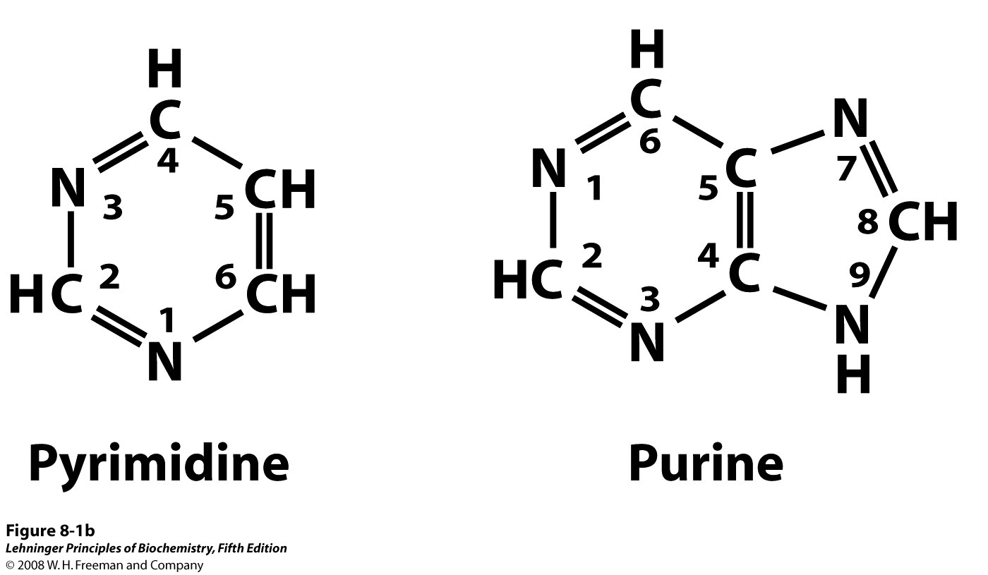
Two Types of Nitrogenous Bases
Notes:
The nitrogenous bases are of two types: purine and pyrimidine. Purines consist of a six-membered and a five-membered nitrogen-containing ring, fused together. Pyridmidines have only a six-membered nitrogen-containing ring.
The numbering conventions are shown. The N-1 of pyrimidine and N-9 of purine are covalently linked to the 1’ carbon of the pentose sugar in DNA and RNA.

Slide 21
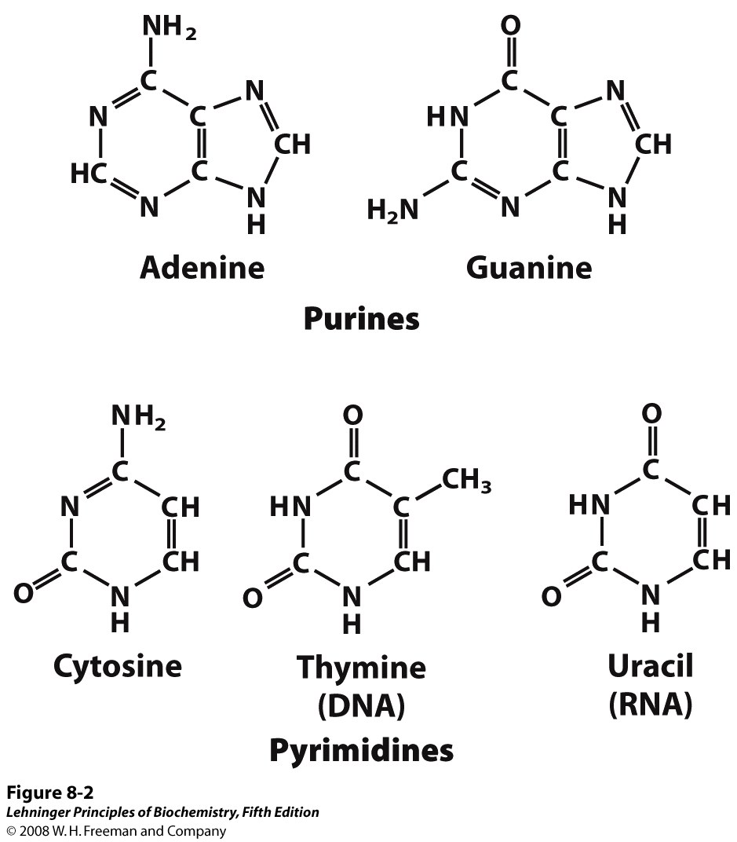
Purine and Pyrimidine Bases
Notes:
Major purine and pyrimidine bases. Adenine, guanine and cytosine are common to both DNA and RNA. It is important to note that Thymine is present in DNA whereas Uracil occurs in RNA.

Slide 22
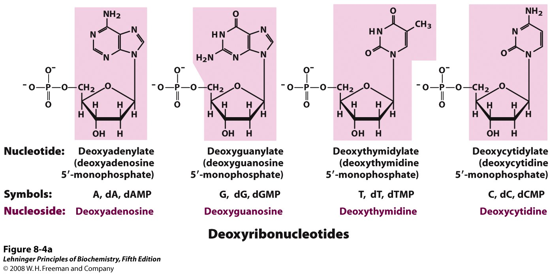
Nucleotide = Nucleoside + Phosphate
(Nucleoside = Sugar + Base)
Notes:
Deoxyribonucleotides and ribonucleotides of nucleic acids. All nucleotides are shown in their free form at pH 7.0. The nucleotide units of DNA (a) are usually symbolized as A, G, T, and C, sometimes as dA, dG, dT, and dC; those of RNA (b) as A, G, U, and C. In their free form the deoxyribonucleotides are commonly abbreviated dAMP, dGMP, dTMP, and dCMP; the ribonucleotides, AMP, GMP, UMP, and CMP. For each nucleotide, the more common name is followed by the complete name in parentheses. All abbreviations assume that the phosphate group is at the 5′ position. The nucleoside portion of each molecule is shaded in pink. In this and the following illustrations, the ring carbons are not shown.

Slide 23
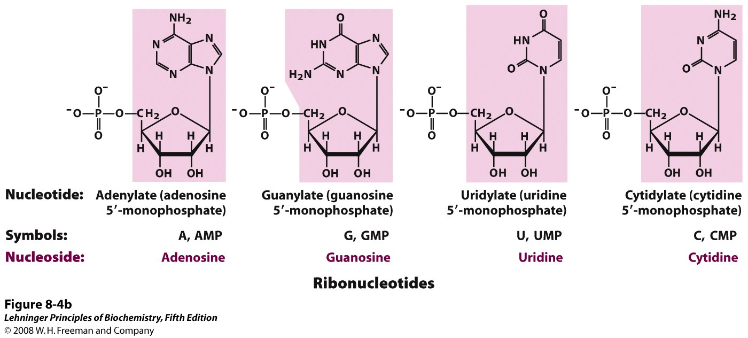
Nucleotide = Nucleoside + Phosphate
(Nucleoside = Sugar + Base)
Notes:
Deoxyribonucleotides and ribonucleotides of nucleic acids. All nucleotides are shown in their free form at pH 7.0. The nucleotide units of DNA (a) are usually symbolized as A, G, T, and C, sometimes as dA, dG, dT, and dC; those of RNA (b) as A, G, U, and C. In their free form the deoxyribonucleotides are commonly abbreviated dAMP, dGMP, dTMP, and dCMP; the ribonucleotides, AMP, GMP, UMP, and CMP. For each nucleotide, the more common name is followed by the complete name in parentheses. All abbreviations assume that the phosphate group is at the 5′ position. The nucleoside portion of each molecule is shaded in pink. In this and the following illustrations, the ring carbons are not shown.

Slide 24
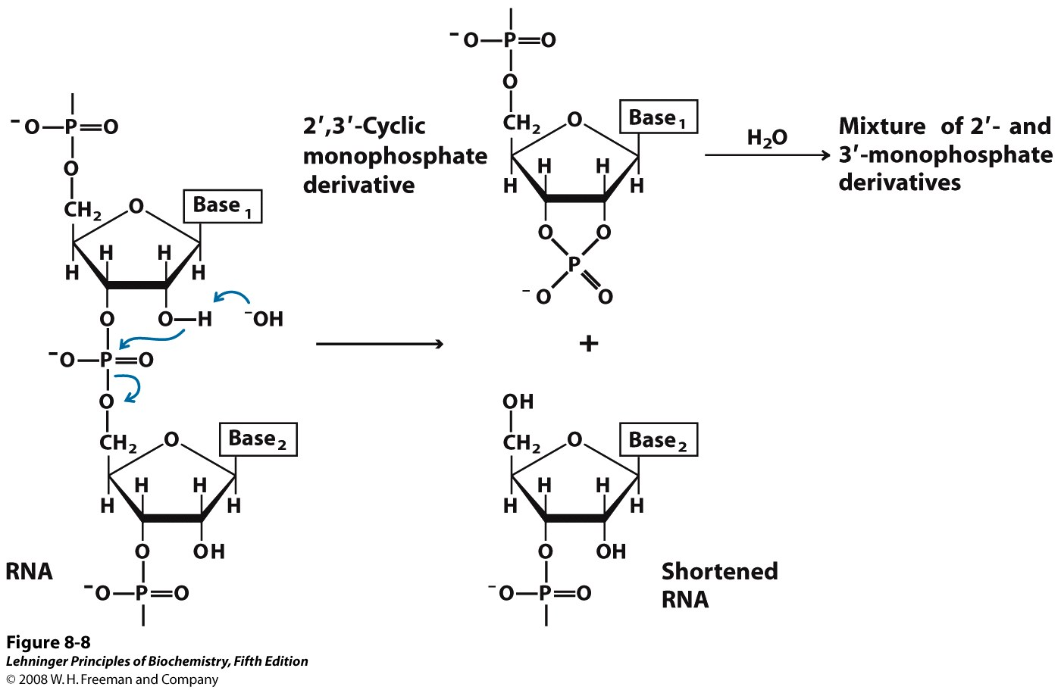
RNA is Less Stable than DNA
Notes:
Hydrolysis of RNA under alkaline conditions.
There are three reasons why DNA is more stable than RNA
Double Strand: DNA is double stranded which makes it stable because Hydrogen bonding between bases release free energy providing it thermodynamic stability.
Lacking 2′ OH: OH groups are reactive by nature. However, in DNA the sugar molecule does not have a spare OH group. The sole OH group it possess is used up in making phosphodiester bonds. This further makes DNA immune to chemical reactions. While RNA has extra OH group which making it chemically promiscuous. The 2′ hydroxyl acts as a nucleophile in an intramolecular displacement. The 2′,3′-cyclic monophosphate derivative is further hydrolyzed to a mixture of 2′- and 3′-monophosphates. DNA, which lacks 2′ hydroxyls, is stable under similar conditions.
Stability of Thymine over Uracil: Thymine is more resistant to photomutation than Uracil. This makes DNA resistance stronger towards radioactive mutagenic agents.
The more stable DNA is used to store genetic information whereas the less stable RNA is used as an intermediate copy for protein synthesis (See Central Dogma).

Slide 25
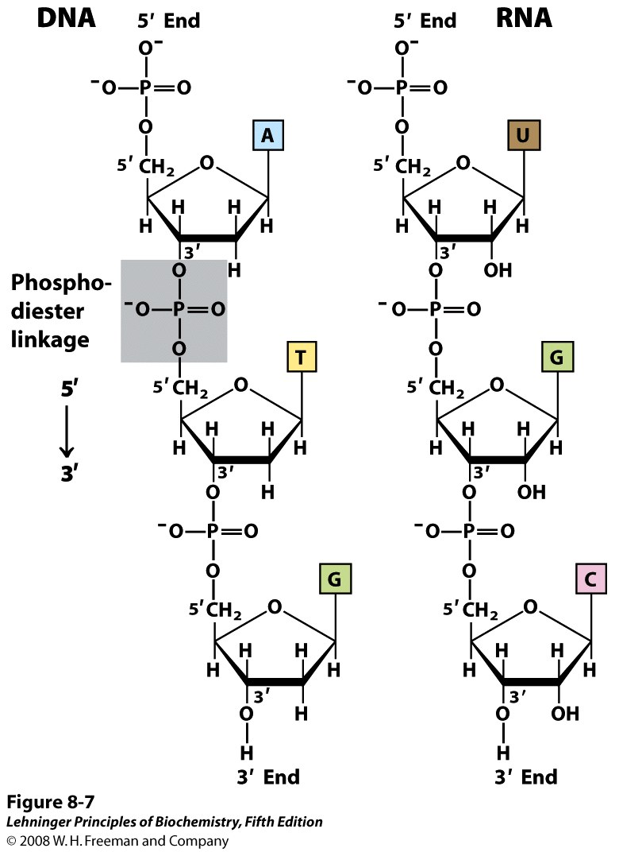
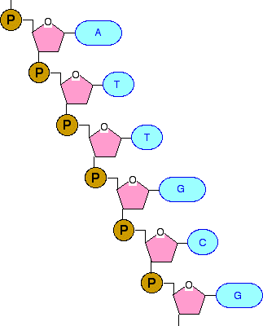
Phosphodiester Linkages in the Covalent Backbone of Nucleic Acid
Notes:
First take a look at the left hand side figure. It gives you an idea of the backbone of DNA structure. The 5’ and 3’ end of the backbone is given on the right hand side figure.
A single nucleotide chain contains a pentose-phosphate backbone. Individual pentose rings are connected through phospho-diester bonds. Phosphodiester linkage is created when a phosphoric acid molecule (H₃PO₄) is linked with two hydroxyl groups (–OH) of two other molecules, forming two ester bonds and removing two water molecules. In a polynucleotide chain, nucleotides are linked together by phosphodiester bonds. A phosphodiester bond occurs when phosphate forms two ester bonds. The first ester bond already exists between the phosphate group and the sugar of a nucleotide. The second ester bond is formed by reacting to a hydroxyl group (–OH) in a second molecule. Each formation of an ester bond removes a water molecule.
Each of these phospho-diester bonds connect the 3’- and 5’-OH groups. The chain has an end to end chemical orientation having 5’-phosphate at one terminal and 3’-OH at the other. Later in this class we will see that the DNA or RNA polymerase synthesizes the nucleic acid chains from 5’ to 3’ orientation. Hence the convention is to read the nucleic acid chain from 3’ to 5’ direction.

Slide 26
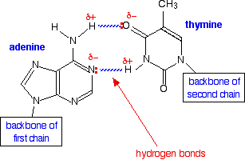
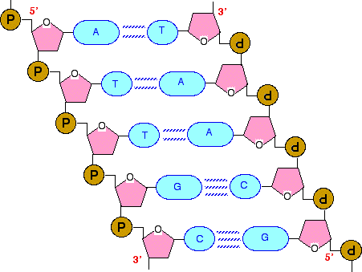
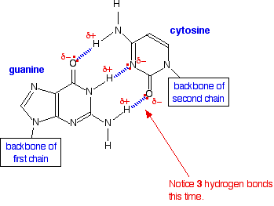
DNA: Deoxyribonucleic Acid
Notes:
The nitrogenous bases form hydrogen bonds between opposing DNA strands to form the rungs of the "twisted ladder" or double helix of DNA or a biological catalyst that is found in the nucleotides

Slide 27
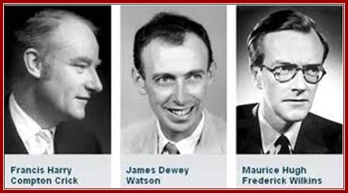
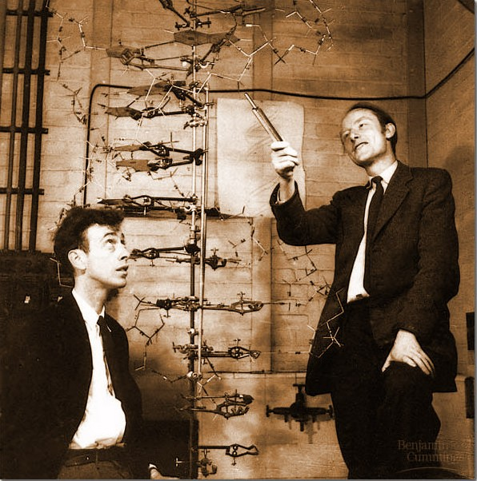
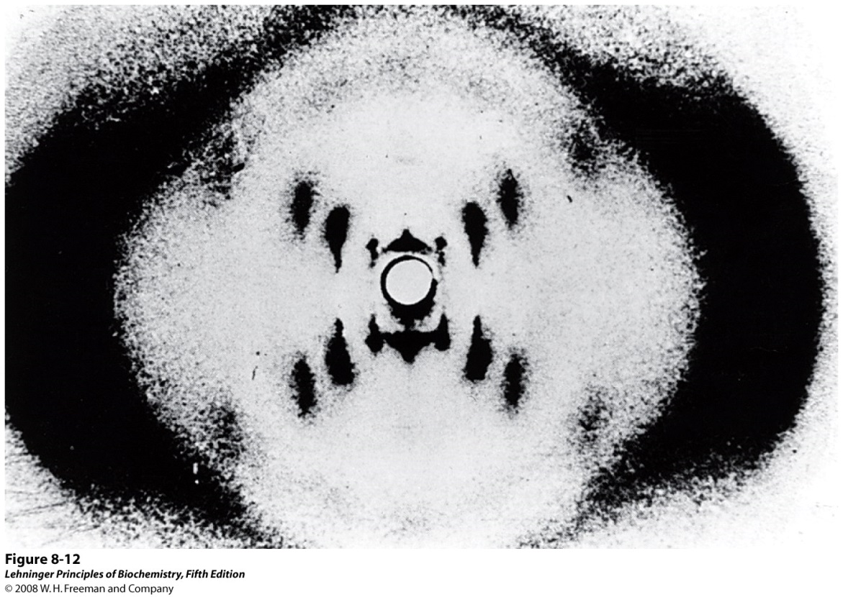
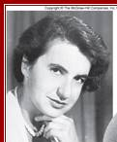
Discovery of the DNA Structure
Structure was discovered in 1953 by James Watson and Francis Crick
Awarded Nobel Prize in 1962
Rosalind Franklin
Notes:
Many people believe that American biologist James Watson and English physicist Francis Crick discovered DNA in the 1950s. In reality, this is not the case. Rather, DNA was first identified in the late 1860s by Swiss chemist Friedrich Miescher. Then, in the decades following Miescher's discovery, other scientists--notably, Phoebus Levene and Erwin Chargaff--carried out a series of research efforts that revealed additional details about the DNA molecule, including its primary chemical components and the ways in which they joined with one another. Without the scientific foundation provided by these pioneers, Watson and Crick may never have reached their groundbreaking conclusion of 1953: that the DNA molecule exists in the form of a three-dimensional double helix.
Phoebus Levene was the first to discover the order of the three major components of a single nucleotide (phosphate-sugar-base); the first to discover the carbohydrate component of RNA (ribose); the first to discover the carbohydrate component of DNA (deoxyribose); and the first to correctly identify the way RNA and DNA molecules are put together.
Chargaff's realization that A = T and C = G, combined with some crucially important X-ray crystallography work by English researchers Rosalind Franklin and Maurice Wilkins, contributed to Watson and Crick's derivation of the three-dimensional, double-helical model for the structure of DNA. Watson and Crick's discovery was also made possible by recent advances in model building, or the assembly of possible three-dimensional structures based upon known molecular distances and bond angles, a technique advanced by American biochemist Linus Pauling. In fact, Watson and Crick were worried that they would be "scooped" by Pauling, who proposed a different model for the three-dimensional structure of DNA just months before they did. In the end, however, Pauling's prediction was incorrect.
DNA structure was discovered in 1953 by James Watson and Francis Crick based upon the x-ray diffraction data obtained by Rosalind Franklin and Maurice Wilkins. They proposed a double helix structure for double stranded DNA with A always hydrogen bonded to T and G with C.

Slide 28
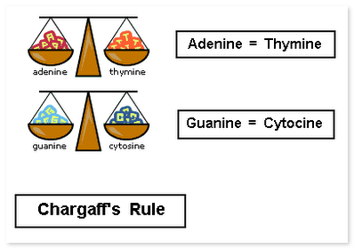
Some key features of DNA
In DNA, two nucleic acid strands anneal together through extensive inter-strand H-bonding between the bases. This base pairing follows the rule proposed by Watson and Crick.
Chargaff’s rule: A always pairs with T and G pairs with C
Hence the two strands become complementary to each other
Notes:
Chargaff noted that the nucleotide composition of DNA varies among species. In other words, the same nucleotides do not repeat in the same order. Chargaff concluded that almost all DNA--no matter what organism or tissue type it comes from--maintains certain properties, even as its composition varies. In particular, the amount of adenine (A) is usually similar to the amount of thymine (T), and the amount of guanine (G) usually approximates the amount of cytosine (C). In other words, the total amount of purines (A + G) and the total amount of pyrimidines (C + T) are usually nearly equal.

Slide 29
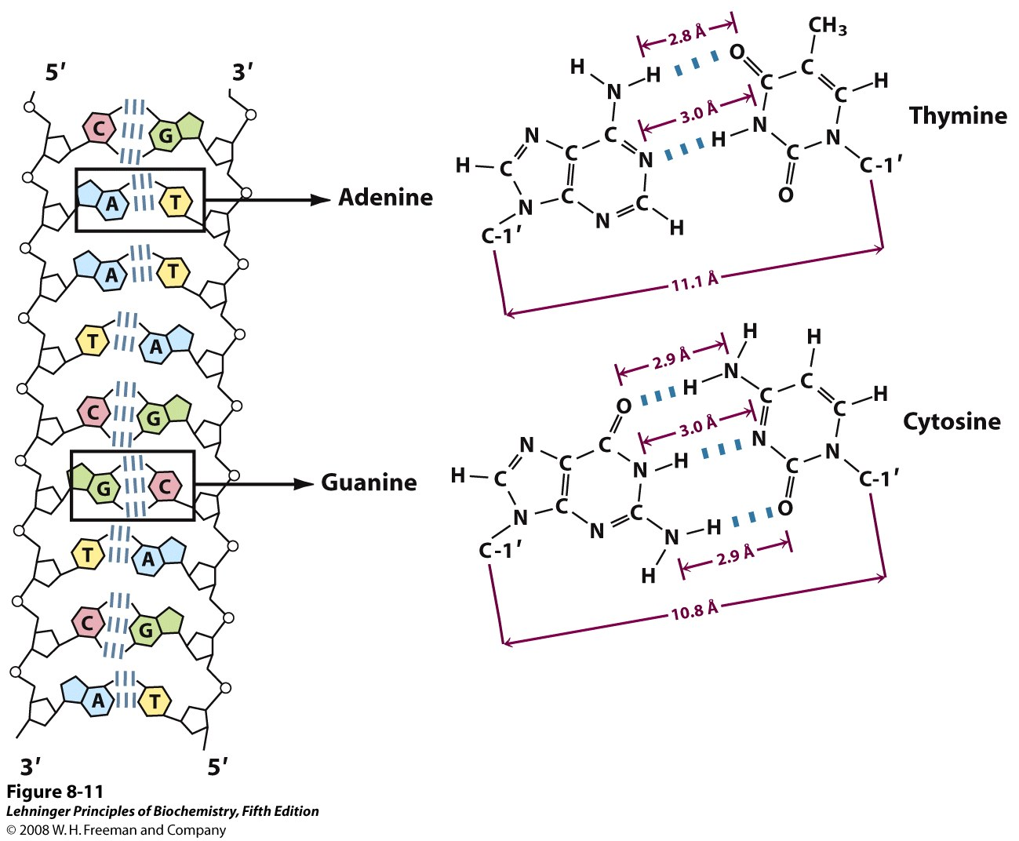
DNA: Deoxyribonucleic Acid
Notes:
In case of DNA two nucleic acid strands anneal together through extensive inter-strand H-bonding between the bases. This base pairing follows the rule proposed by Watson and Crick. A always pairs with T and G with C (Chargaff’s rule). Hence the two strands become complementary to each other. Directionality of two strands is opposite: one is 5’-3’ and another is 3’-5’. Hence complementary DNA strands are antiparallel. The base-paired antiparallel strands differ in base composition: the left strand has the composition A₃ T₂ G₁ C₃; the right, A₂ T₃ G₃ C₁.
Directionality of two strands is opposite: one is 5’-3’ and another is 3’-5’
Hence complementary DNA strands are antiparallel

Slide 30
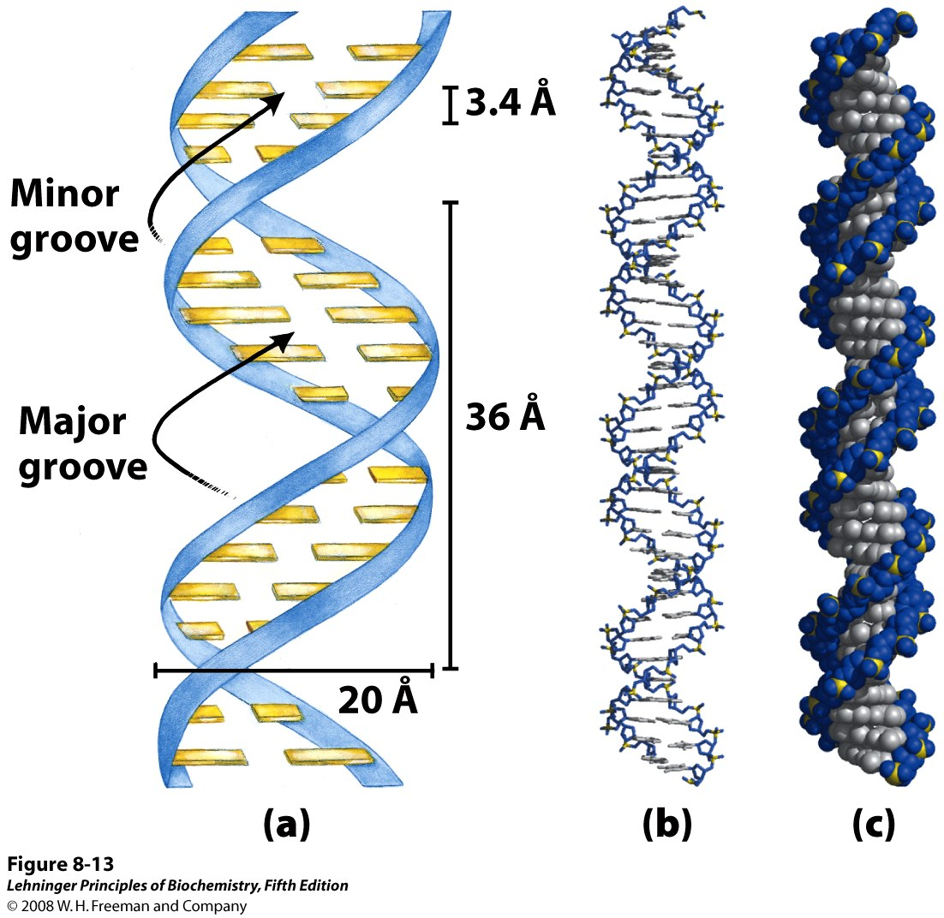
Watson-Crick Model for the Structure of DNA
a
b
c
Notes:
Watson-Crick model for the structure of DNA. In this structure, the pentose phosphate backbone of the DNA strands, which is significantly polar in nature remains outside and the bases which are hydrophobic pointed towards inside. The bases of the anti-parallel strands participates in H-bonding with each other. The original model proposed by Watson and Crick had 10 base pairs, or 34 Å (3.4 nm), per turn of the helix; subsequent measurements revealed 10.5 base pairs, or 36 Å (3.6 nm), per turn. (a) Schematic representation, showing dimensions of the helix. (b) Stick representation showing the backbone and stacking of the bases. (c) Space-filling model.
The spaces in between the interwind strands forms two helical grooves of different width as major and minor grooves. The bases are accessible to outside molecules, like water or DNA binding proteins and forms two different kinds of binding surfaces for them.

Slide 31
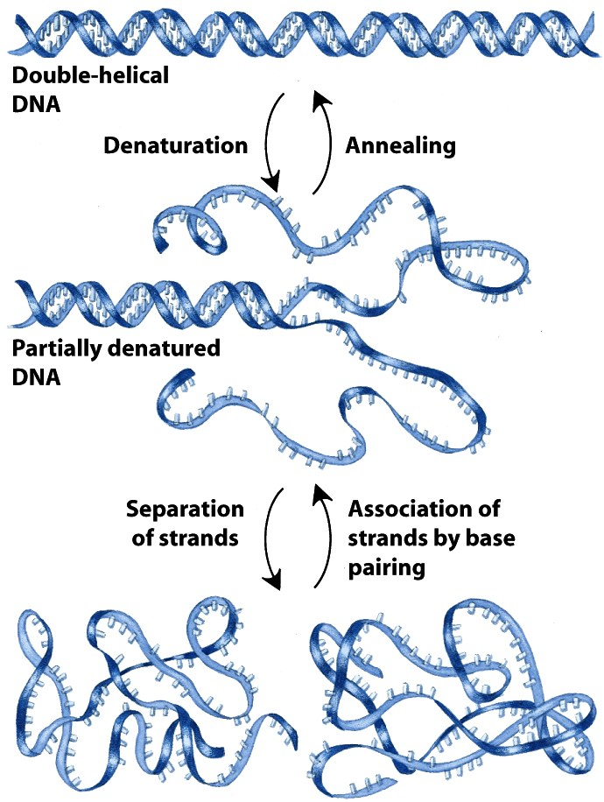
Reversible Denaturation and Annealing (Renaturation) of DNA
Notes:
Reversible denaturation and annealing (renaturation) of DNA.
If a DNA solution is heated to approximately 90°C or above there will be enough kinetic energy to denature the DNA completely causing it to separate into single strands. This denaturation is very abrupt and is accelerated by chemical reagents like urea and formamide. The chemicals enhance the aqueous solubility of the purine and pyrimidine groups.
Upon denaturation, the hydrophobic bases gets exposed to outside solvent hence becomes insoluble and precipitated out. That’s why if you denature DNA using heat or other chemical reagents it forms insoluble matter.
If melted DNA is cooled it is possible to re-associate the separated strands, a process known as renaturation. However, a stable double-stranded molecule may be formed only if the complementary strands collide in such a way that their bases are paired precisely.
When preparations of double-stranded DNA are denatured and allowed to renature, the rate of renaturation can give valuable information about the complexity of the DNA if there are repetitive sequences in the DNA.
Double stranded DNA helix is the energetically favourable structure. That’s why, it takes energy to denature the DNA. Entropy decreases. Free energy increases. Non-spontaneous process.

Slide 32
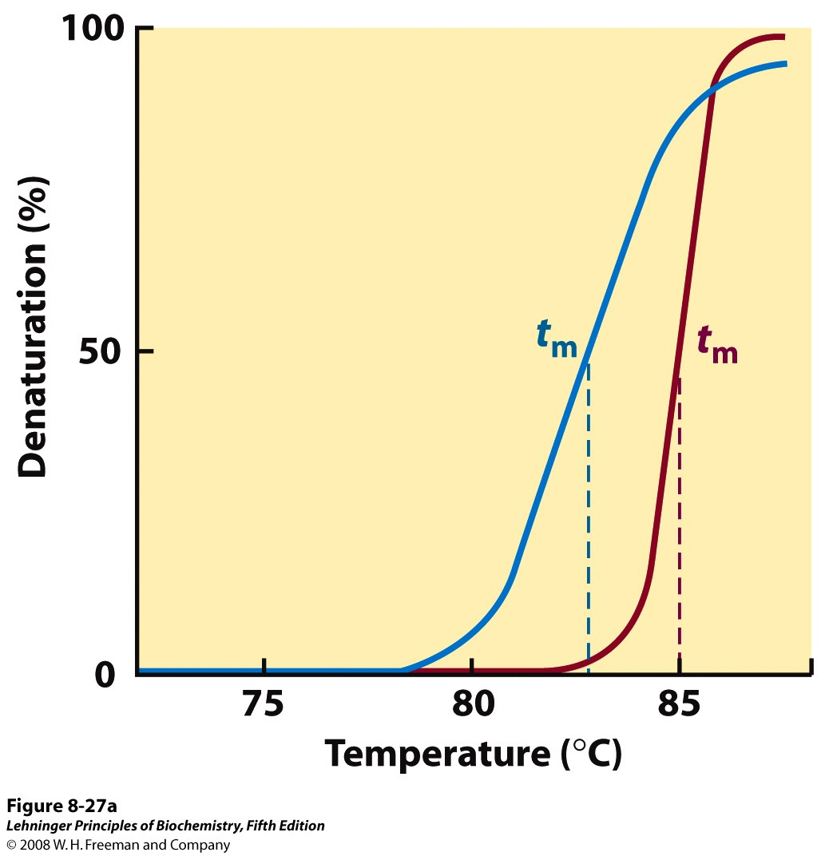
Heat Denaturation of DNA
Notes:
Heat denaturation of DNA. This separation of double helix is called melting as it occurs abruptly at a certain characteristic temperature called denaturation temperature or melting temperature (T_{m}). It is defined as temperature at which 50% of the DNA is melted. The melting of DNA can be followed spectrophotometrically by monitoring the absorbance of DNA at 260 nm. The T_{m} value depends on the nature of the DNA; it depends on pH and ionic strength and on the size and base composition of the DNA. If several samples of DNA are melted, it is found that the T_{m} is highest for those DNAs that contain the highest proportion of G—C. Actually the value is used to estimate the percentage of G—C in a DNA sample. In fact, the T_{m} of DNA from many species varies linearly with G—C content. This relationship between T_{m} and G—C content arises due to guanine and cytosine form three hydrogen bonds when base paired, whereas adenine and thymine form only two.

Slide 33
Study and reference materials
DNA as storage device:
https://www.youtube.com/watch?v=60Gi5lqL-dA&feature=emb_title
DNA as transforming principle:
https://www.ncbi.nlm.nih.gov/books/NBK22104/
DNA structure:
https://www.youtube.com/watch?v=o_-6JXLYS-k
Lehninger Principles of Biochemistry

